Slide 1
Data Science Path
To be able to convert raw material into useful

Slide 2
Resource
Book
Python Data Science Handbook
https://www.pdfdrive.com/python-data-science-handbook-e43755558.html
https://github.com/jakevdp/PythonDataScienceHandbook
Author
Jake VanderPlas
Interested in astronomy

Slide 3
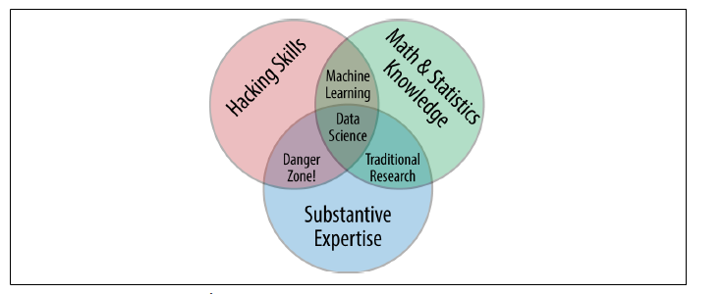
What is Data Science
Notes:
Machine Learning for Hackers by Drew Conway
PhD in Political Science

Slide 4
Data Science my View
Data into Information
Structured
Semi Structured
Unstructured
To Understand the meaning of data to understand the science of data

Slide 5
Why Python ?
Python is extensively used for DS
Not a guide to the python
Only essential knowledge for working with data
Use Python 3
https://en.wikipedia.org/wiki/Python_(programming_language)

Slide 6
How this Course is divided ?
IPython
Numpy
Pandas
Matplotlib
Scikit-Learn

Slide 7
Setup
Anaconda Distribution
Miniconda
Anaconda
https://en.wikipedia.org/wiki/Anaconda_(Python_distribution)

